Slide 1
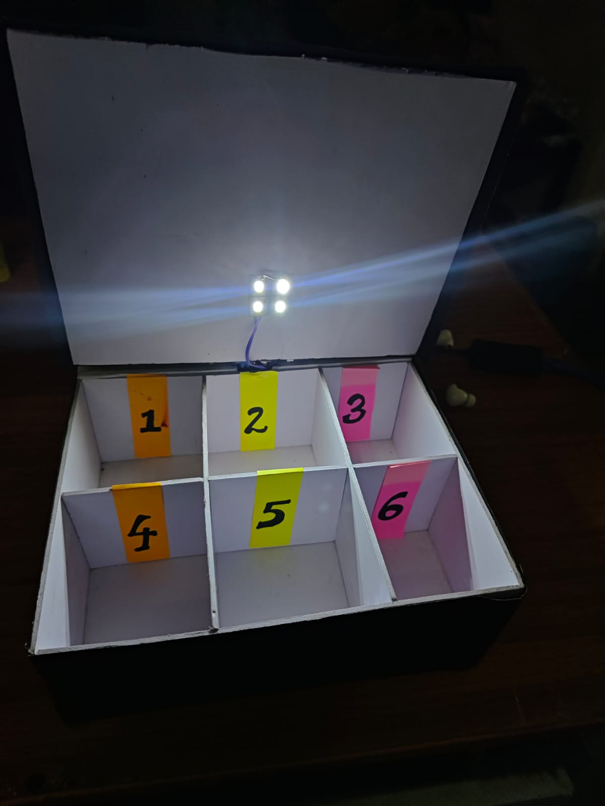
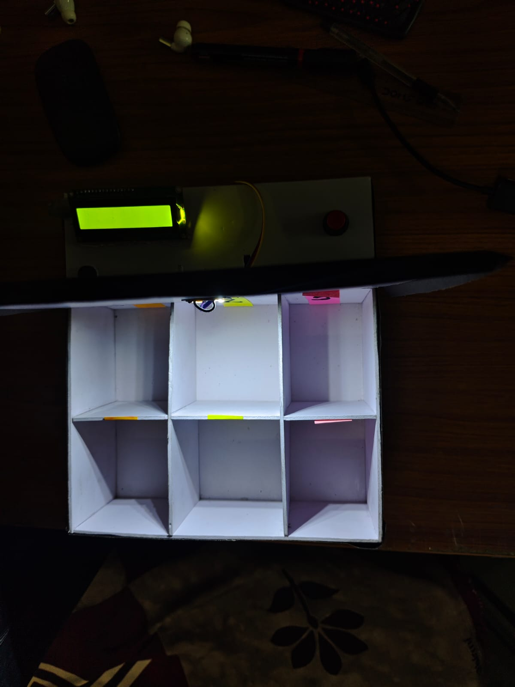
Smart Health Companion Box
SAARTHI (सारथि)
An Automated Medication Reminder & Dispensing System
"One missed dose can cost your health . One smart reminder can protect it."

Slide 2

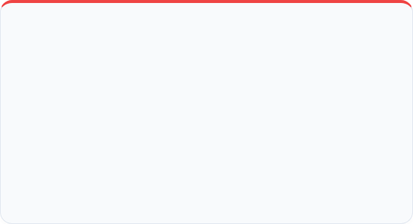
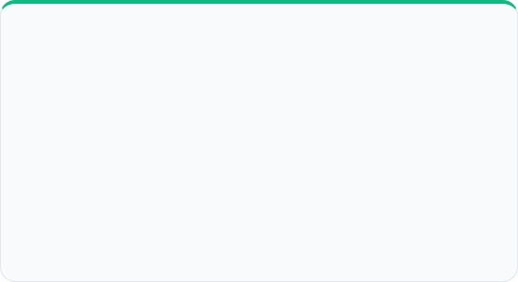


The Problem & Our Solution
The Challenge
The Solution
Patients frequently forget to take medications on time, leading to poor health outcomes.
Caregivers lack real-time visibility into whether doses were taken or missed.
An IoT-enabled medical box that alerts patients precisely at dosage times via alarms and displays.
It connects to the Blynk app, allowing caregivers to manage schedules and monitor compliance remotely.

Slide 3
Hardware Components (BOM)
Component Name | Function in Project | Connection / Pin
NodeMCU ESP8266 | Main microcontroller & WiFi IoT brain | Central Hub
16x2 LCD (with I2C) | Displays Date, Time, and Next Medicine info | D1 (SCL), D2 (SDA)
SG90 Servo Motor | Acts as a locking mechanism for the lid | D7
Push Button | Acknowledges dose & toggles lid open/close | D6 (Input Pullup)
Active Buzzer | Audible alarm when medication is due | D5
LED Light Strip | Illuminates the internal compartments | D8

Slide 4
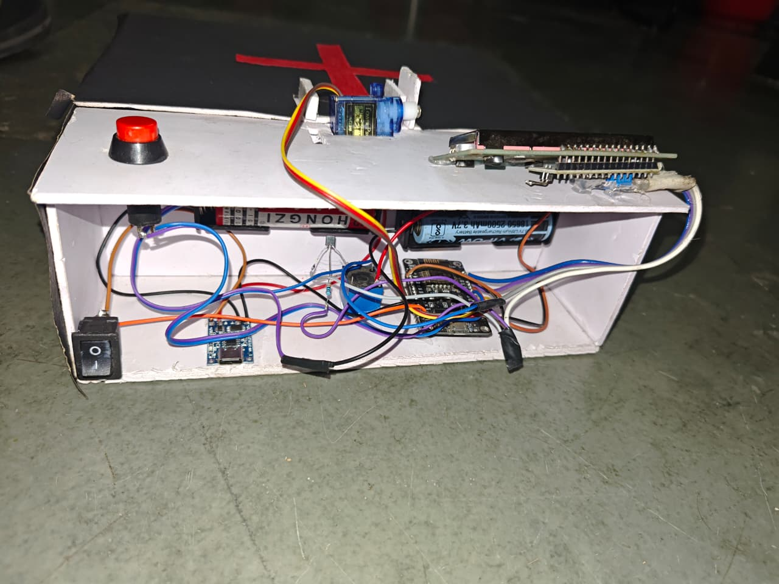
Exterior Interface
Information Display: The 16x2 LCD provides continuous updates. It toggles between the current time/date and the name/time of the next scheduled medicine.
Interactive Button: A single red push button serves a dual purpose. It silences the alarm to confirm a dose is taken, and triggers the servo to open the lid.
Secure Locking: The blue SG90 Servo motor acts as a physical latch, keeping the box closed until the correct time or user intervention.

Slide 5
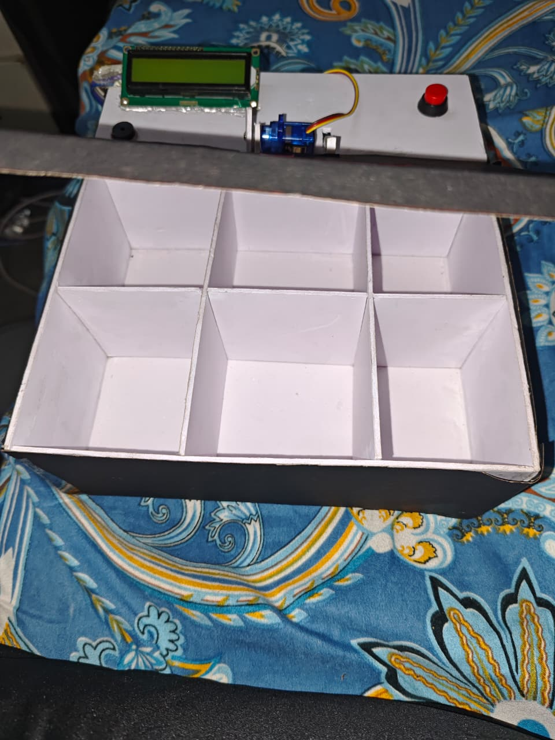
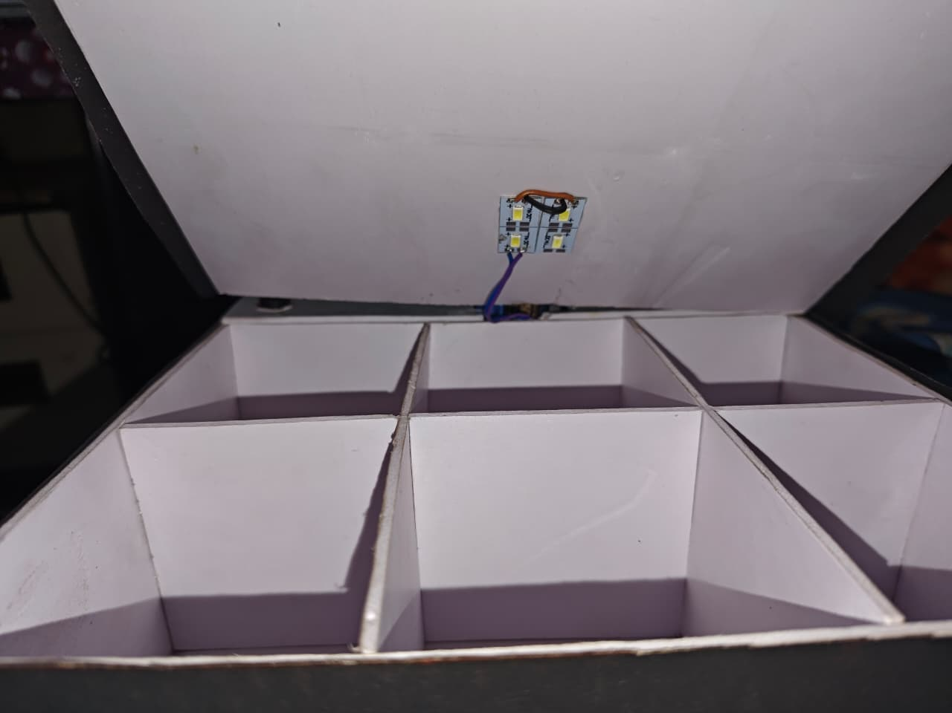
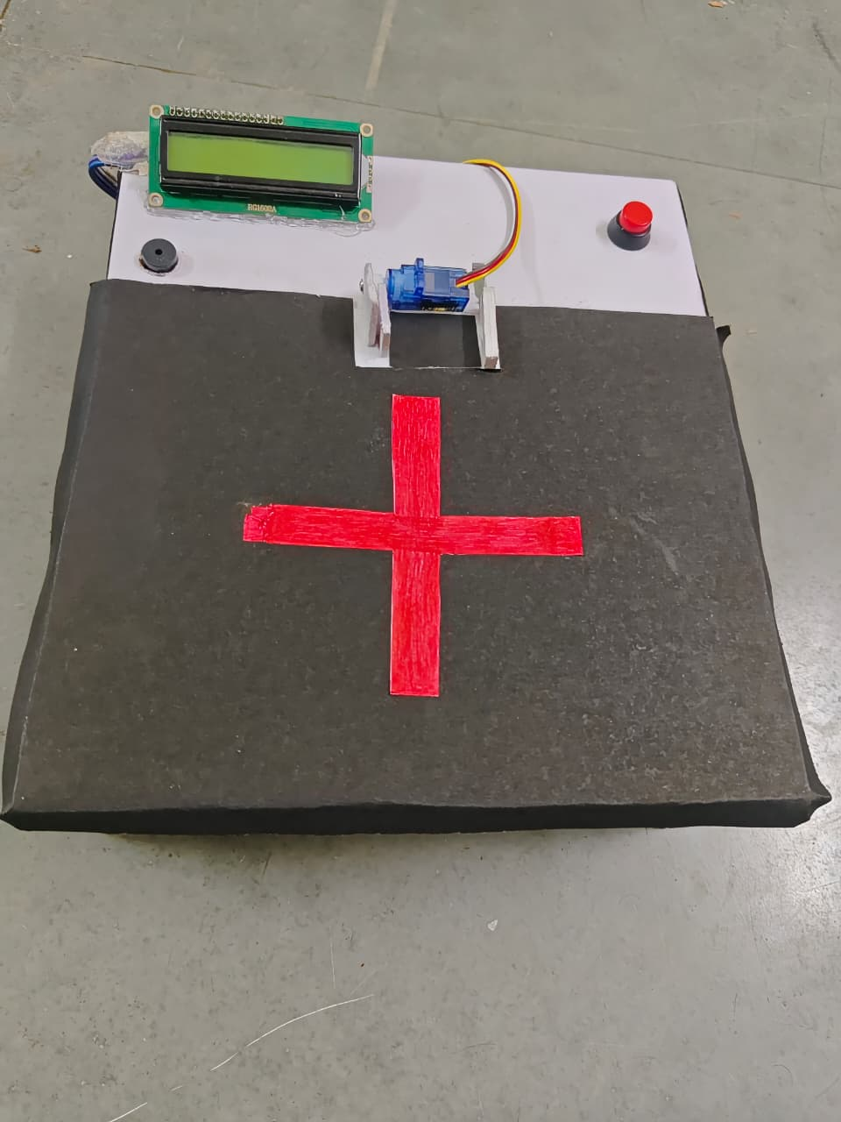
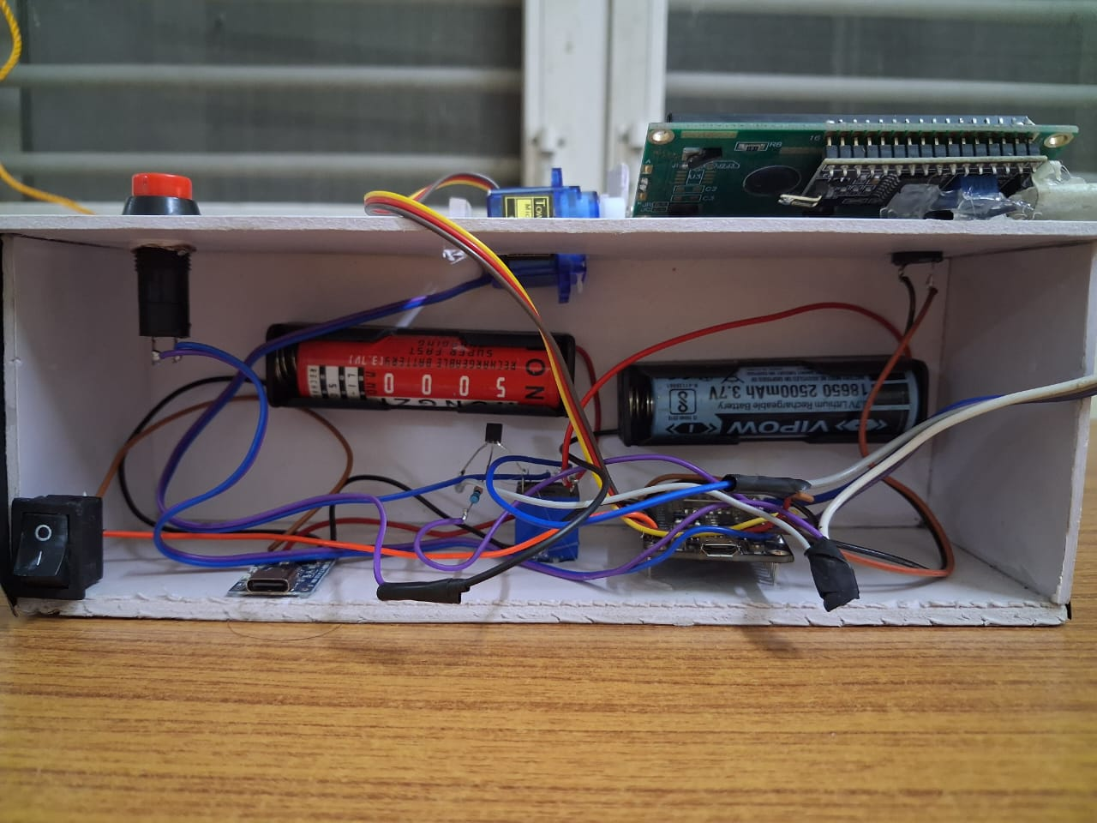
Internal Compartments
Organized Storage: The interior is divided into 6 spacious compartments, allowing for the segregation of different pills, capsules, or daily doses.
Safe & Clean: The physical separation prevents cross-contamination of medicines and makes it easier for elderly patients to pick the correct pill.
App Synchronization: The physical pill counts in these compartments are tracked digitally in the Blynk IoT app, ensuring inventory is monitored.

Slide 6
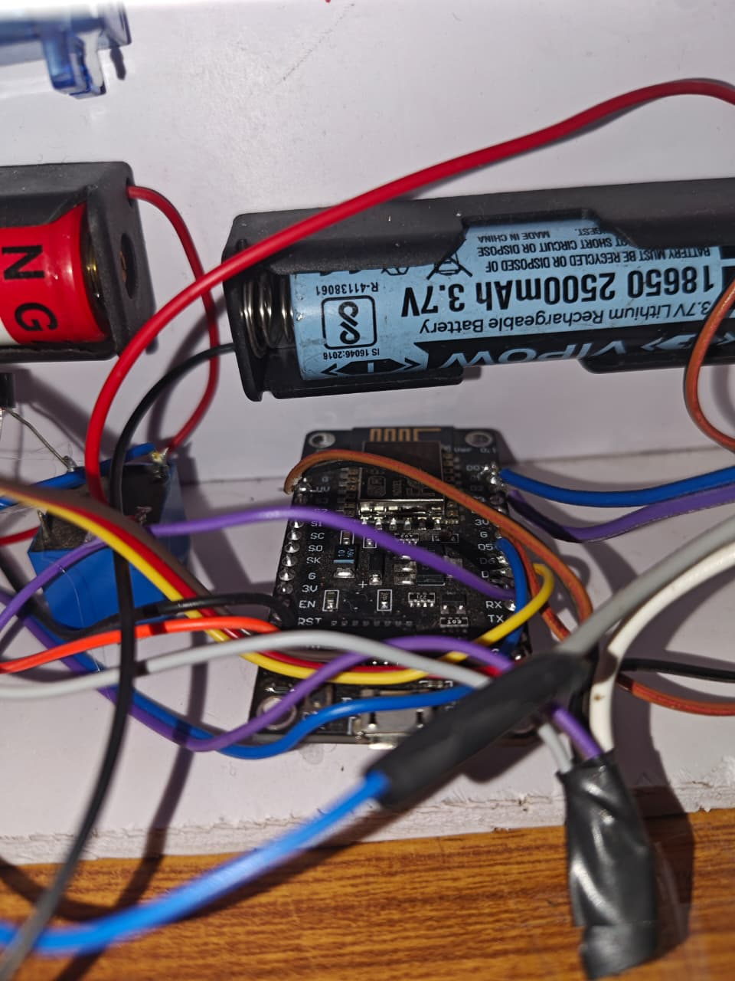

Circuit & Connections
The brain of the system is the NodeMCU ESP8266, powered by 18650 Li-ion rechargeable batteries. Here is the pin mapping used in the code:
D5: Buzzer (Output)
D6: Push Button (Input)
D7: Servo Motor (PWM Output)
D8: LED Light (Output)
D1/D2: I2C Communication for LCD
Note: A master switch is installed to cut off battery power when not in use.

Slide 7
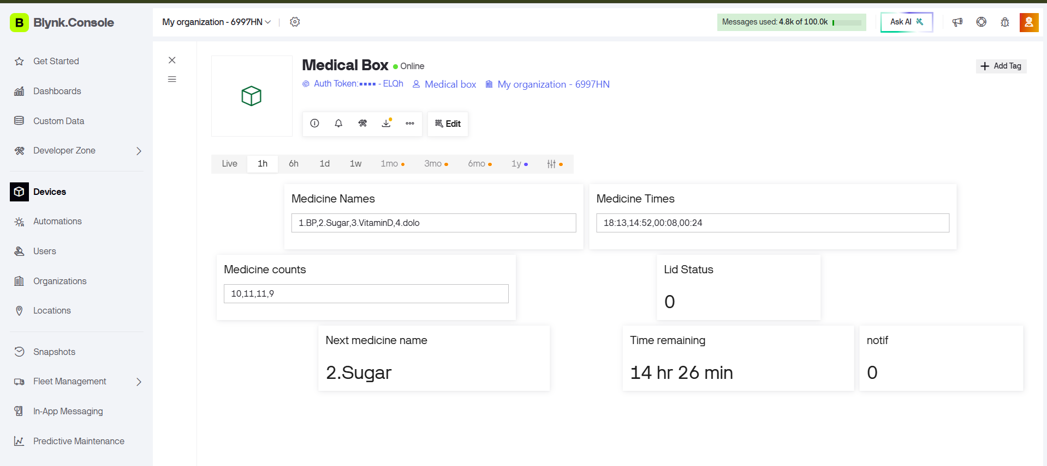

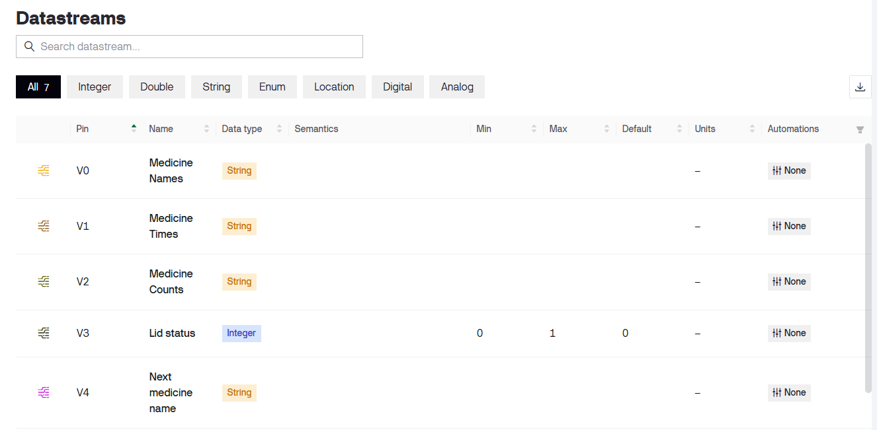
Smart Illumination
Night-time Accessibility
A bright LED array is mounted on the interior of the lid, connected directly to Pin D8 of the NodeMCU.
Automated Trigger: When the button is pressed and the servo opens the box, the code executes digitalWrite(light, HIGH).
Enhanced Visibility: This feature is crucial for patients taking medication in low-light conditions or during the night.
Energy Efficient: The light automatically turns off (LOW) when the lid is commanded to close.

Slide 8
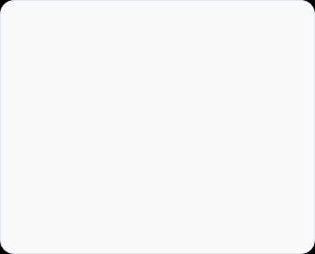
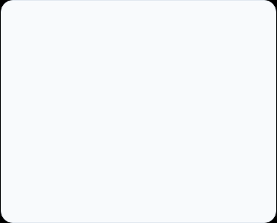
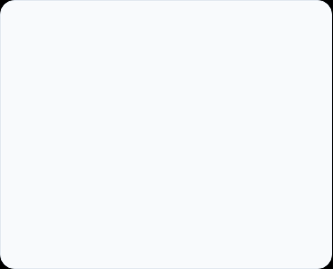



Software & IoT Integration (Blynk)
Data Retrieval
Time Synchronization
Live Status Updates
The code uses Virtual Pins to fetch comma-separated data from the Blynk App: V0 (Names), V1 (Times), and V2 (Counts).
Uses configTime() with NTP servers (pool.ntp.org) to keep accurate real-time. It constantly calculates the time difference to the next dose.
The ESP8266 pushes updates back to the app via V4/V5 (Next Med info) and V6 (Missed/Taken status flag).

Slide 9
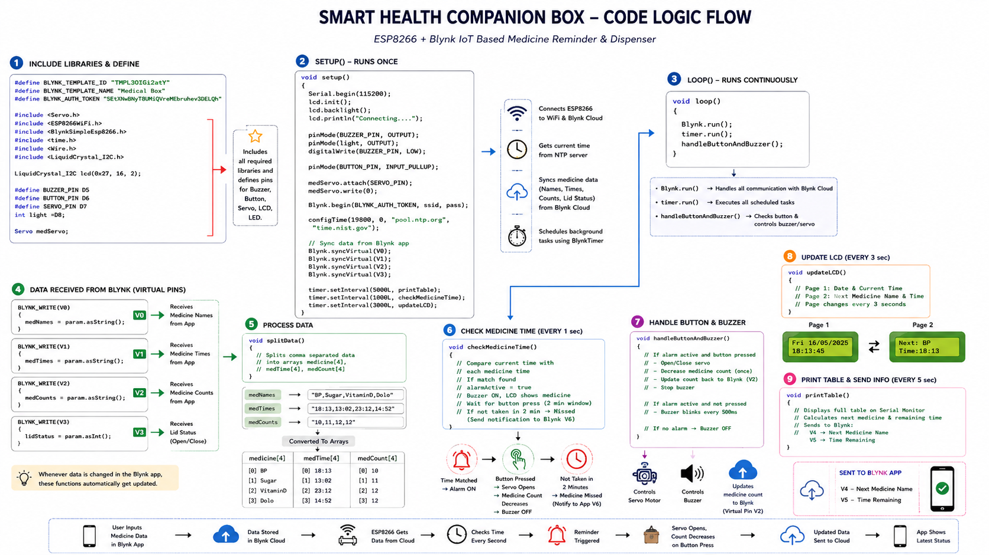

Slide 10




How It Works (Process Flow)
Schedule Set
Time Matching
Alert Phase
Action & Update
Caregiver enters up to 4 medicine names, times, and initial pill counts in the Blynk App.
Device syncs time. When real time matches the scheduled time, alarmActive becomes true.
Buzzer blinks every 500ms. LCD displays "MEDICINE TIME STARTED". Device waits for interaction.
User presses button. Buzzer stops, servo opens lid, LED turns on. Pill count decrements and syncs to App.

Slide 11
Future Scope & Enhancements
Biometric Security: Integrating a fingerprint sensor to ensure only the authorized patient can open the medication box.
Battery Management: Implementing deep sleep modes for the ESP8266 to extend the 18650 battery life from days to months.
Vision/Camera Integration: Adding an ESP32-CAM to visually verify that the patient actually ingested the medication, rather than just opening the box.
Voice Assistant Integration: Connecting the Blynk webhooks to Alexa or Google Assistant to announce the medicine name out loud.

Slide 12
Questions?
Thank you for your attention.
NOTE : "One missed dose can cost your health. One smart reminder can protect it."
Build By - ROHAN (24BEC104) , AFTAB (24BEC076) , DHRUV (24BEC032)
PRACHETUS (24BEC093) , SAMARTH (24BEC107)

